Slide 1



Acknowledgements
NASA
Jack Crabtree
Mr. William Stein
ANSR Volunteers
Team A:
Nate Thomas Freeman
Marissa Jimenez
Brett Laine
Chet Andrew Martinez-Droeg
Team B:
Stephanie Booth
Zakkery Lauren Diaz
Gjergji Joco
John T Stephenson
Achilles Tsantarliotis

Slide 2
Organization
Project Manager :Oscar Alvidrez Arzate
Electrical : Chet Martinez-Droeg
Payload design: Nathan Freeman and Marissa Jimenez
Programming : Brett Laine

Slide 3
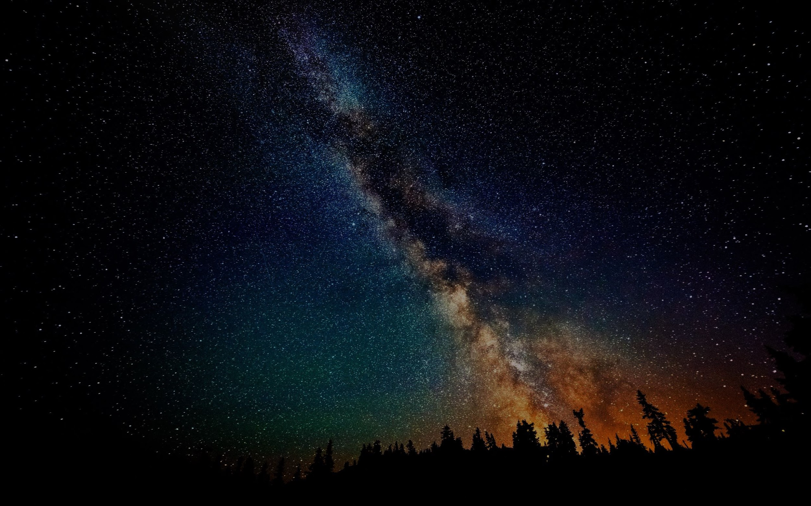
Project Manager
Oscar Alvidrez Arzate

Slide 4
Overview
Collect data in the extremes of high altitude
Gain experience about various engineering fields

Slide 5
How we achieved our goals
Followed a strict budget
Drew upon past experience to improve payload design
Team work

Slide 6

Accomplished
Successfully sent up and retrieved Payload
Learned what it takes to form a working engineering team
Formed new friendships

Slide 7
Electrical
Chet Martinez-Droeg

Slide 8
Central Processing Unit
Raspberry Pi Model B
  700MHz ARMv6 CPU
  Broadcom Video Core IV GPU
  512 MB RAM
  I2C
  SPI
  8GB SD card running Raspbian OS
Anker portable cellphone charger (6000 mAh)
  5V/2A output

Slide 9
Instruments
Si1145 Digital UV Sensor
DS1307 Real Time Clock
Adafruit Ultimate GPS Breakout
Raspberry Pi Camera
MAX31855 Thermocouple Amplifier
Parallax MS5607 Altimeter/Temperature Module
Adafruit Pi Cobbler Breakout

Slide 10
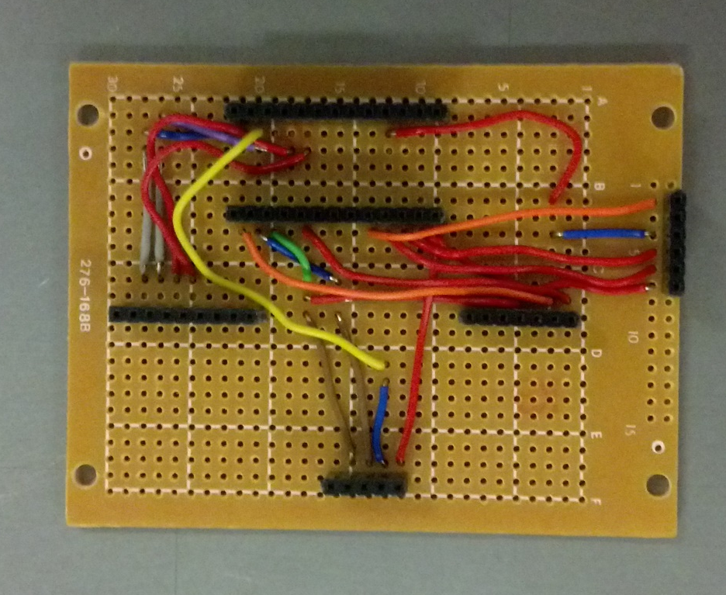
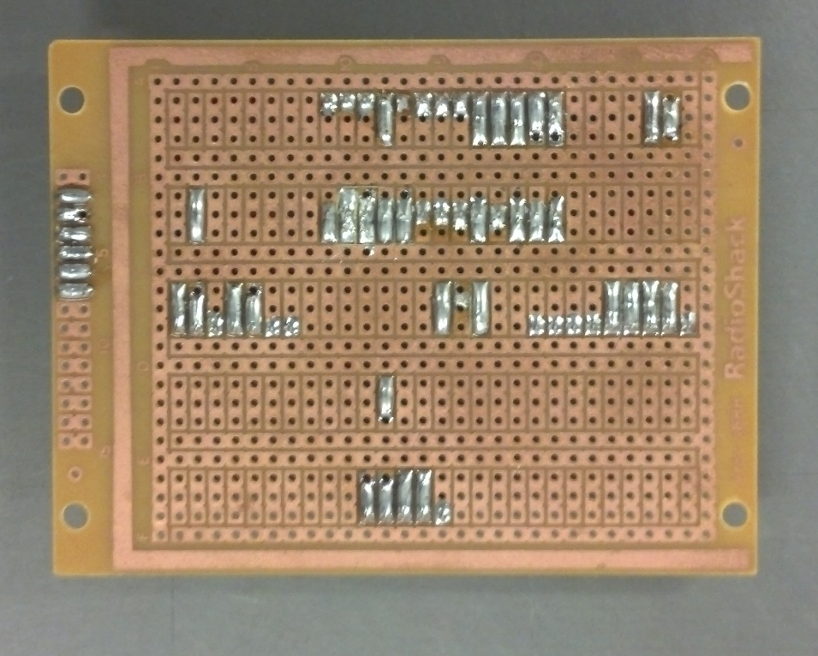
Circuit Board
Fall Semester

Slide 11
Programming
Brett Laine

Slide 12

Programming
Raspbian Operating System
UNIX Based
  Open source
  Operating system is based on Debian, a Linux distribution, and optimized for the Raspberry Pi hardware
  Comes with over 35,000 packages

Slide 13

Python on the PI
Raspbian comes preinstalled with the Python packages.
IDLE is the integrated development environment (IDE) used for Python on the Pi.

Slide 14
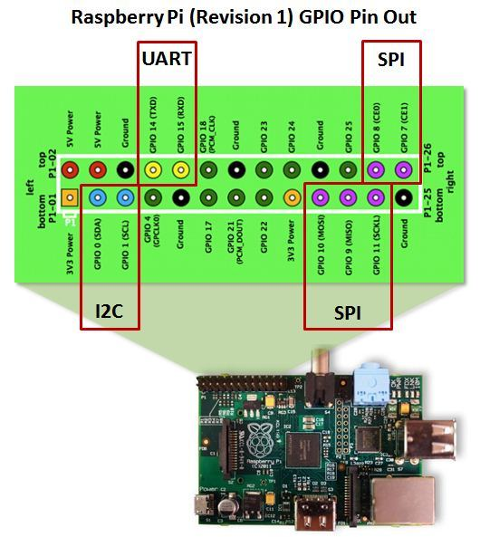

Slide 15
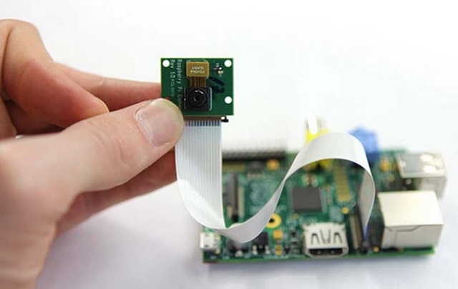
Raspberry Pi Camera Module

Slide 16
Capable of 5 megapixel (2592 x 1944) resolution.
Video capabilities of 1080p30 or 720p60.
A bash script was written to capture and save a picture every 1 minute. (About 0.6gB of storage needed for 3 hours.)

Slide 17
Driving the PCB and Sensors
  Read the sensors according to i2c and SPI standards.
  Data saved into text files. Each consisting of approximately one minute of data.

Slide 18
PCB and Sensors
  Si1145 Digital UV Sensor
  DS1307 Real Time Clock
  Adafruit Ultimate GPS Breakout
  MAX31855 Thermocouple Amplifier
  Parallax MS5607 Altimeter/Temperature Module

Slide 19
Physical Payload Build
Marissa Jimenez
Nathan Thomas Freeman

Slide 20
Physical Payload Build
Why a Sphere
Material Selection
General Design
Specifications
Design Challenges
Overall Successes
Areas for Improvement
What was Learned

Slide 21
Why a Sphere?
Strongest at all points of the surface area
Allowed room for hardware
Minimizes surface to volume ratio

Slide 22
General Design
Exterior Sheer Protection
Compression
Redundancy

Slide 23
Specifications
Goal: ≤1.500 lbs
Semester one: 1.570 lbs.
Semester two: 1.470 lbs.
Diameter
Semester one: 29.21 cm
Semester two: 19.05 cm

Slide 24
Design Challenges
Semester One
  Weight Limit
  Lamp Rod
  Hardware
  Semester Two
  Corrosion
  Structure Failure
  Increased Build Diffculty

Slide 25
Overall Successes
  Sturdy and “friendlier” exterior
  All sensors desired for use implemented
  Interior design sturdy
  Remained under weight limitations

Slide 26
Areas for Improvement
Following a schedule of deadlines more strictly
Communication
More testing
All members learning to contribute to all areas of the project

Slide 27
What we learned
Redundancy
Test Materials before application
Shared Vision
Division of labor

Slide 28
Questions?

